Slide 1
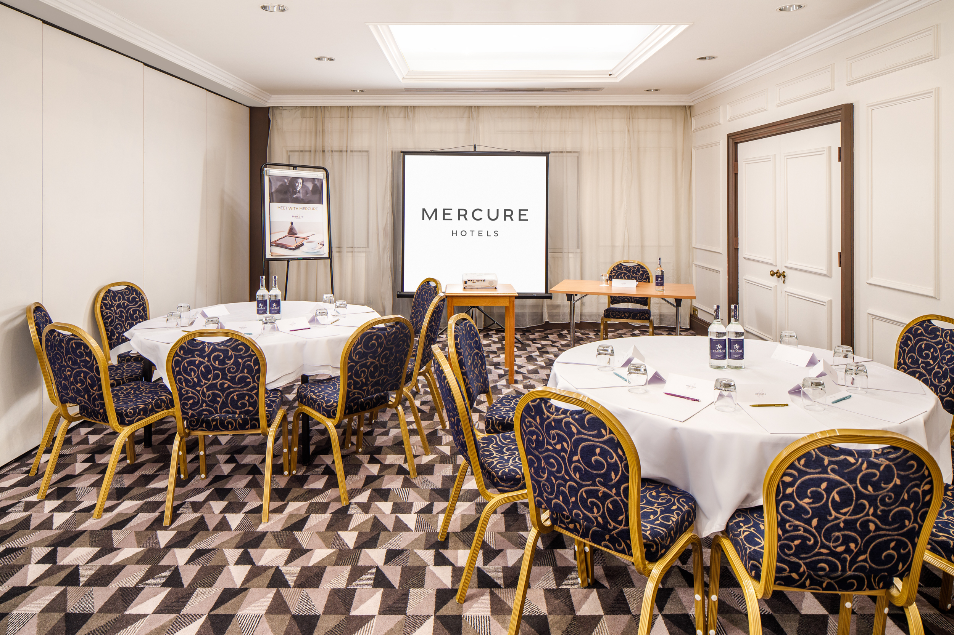
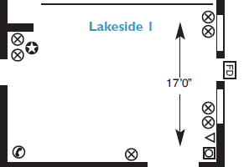

LAKESIDE 1
Part of the Lakeside Suite. Located on the ground floor, the Lakeside One is accessible to all.
Key Information
Floor | Ground
Disabled access | Yes
Natural Daylight | Yes
Air Conditioning | No
Setup | Capacity
Theatre | 20
Cabaret | 16
Boardroom | 20
Classroom | 10
U-shape | 14
Dinner | 20
Room Dimensions
Height | 2.47m
Length & Width | 5.19m x 7.03m
Square Metres | 36.49

